Slide 1
Demystifying Encryption
Taking the First Steps Down the Path to Security
Rob Douglas, Principal Consultant, DataSentinel New Zealand

Slide 2





Thank you to our Global Sponsors and Supporters

Slide 3



Join our community!
Receive regular updates from our community experts and exclusive invites to our community events and workshops.
https://aka.ms/DevNZ

Slide 4

Who is this session for?
Me
Over a decade specializing in SQL Server
Principal Consultant for Data Sentinel
Security scares me
Lack of security scares me more.

Slide 5
What will we cover?
An Introduction To Encryption
And Introduction To The 5 Types Of SQL Encryption
Object Encryption
Backup Encryption
Transparent Data Encryption (TDE)
Always Encrypted
Connection Encryption

Slide 6
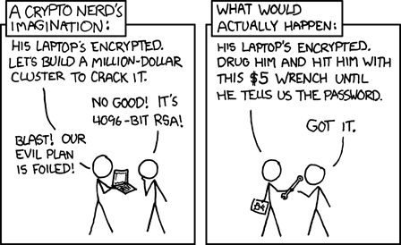
The Scary Slide
So why bother?
Notes:
https://www.toptenz.net/10-most-expensive-data-breaches-and-a-simple-trick-to-protect-your-website.php
https://auth0.com/blog/the-11-biggest-data-breaches-of-2020-so-far/
https://www.cnbc.com/2019/12/17/the-5-biggest-data-hacks-of-2019.html
https://www.cryptopia.co.nz/

Slide 7
What is Encryption?
“Encryption is the process of encoding a message or information in such a way that only authorized parties can access it and those who are not authorized cannot... The intended information or message, referred to as plaintext, is encrypted using an encryption algorithm – a cipher – generating ciphertext that can be read only if decrypted.“
Wikipedia\Encryption

Slide 8
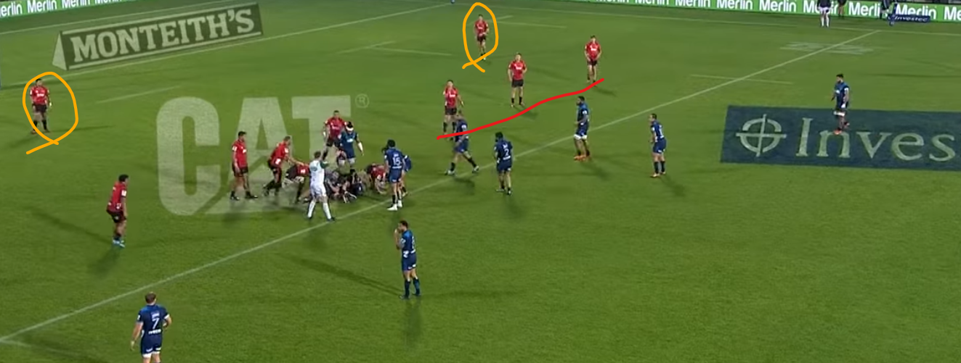
Defense In Depth?

Slide 9
Object Encryption
Available in all versions/editions of SQL Server
Just add WITH ENCRYPTION to object definition
Not really Encrypted - just Obfuscated
Can be decrypted by a malicious user with a small amount of effort
Notes:
https://sqlity.net/en/1617/decrypting-encrypted-database-objects/
A known plaintext attack against an encryption algorithm can be use when you have the ability to get you hand on a particular data set in the encrypted and the unencrypted form.

Slide 10
Object Encryption Demo

Slide 11
Backup Encryption
Introduced in SQL Server 2014
Available in Standard or Enterprise Edition
Encrypts Native Backup files
Based on a certificate stored securely within the SQL Server engine

Slide 12
Backup Encryption Demo

Slide 13
Transparent Data Encryption
Introduced in SQL 2008 Enterprise Edition
Not in SP1 goodies for SQL 2016
It IS in Standard in 2019!
Also based on certificate within the SQL Engine
Encrypts at rest
MDF, NDF, LDF files only
Server-side Encryption and Decryption
Notes:
https://www.sqlservercentral.com/blogs/rotating-tde-certificates-without-re-encrypting-data

Slide 14
Transparent Data Encryption Demo

Slide 15
Transparent Data Encryption – Stuff we learned
Encrypting any one database with TDE also encrypts TempDB
Restoring Backups requires the certificate
Can use TDE AND Backup Encryption
No blocking while encrypting
Best Practice is use separate certificates

Slide 16
Always Encrypted – Column Encryption
Encrypting any one database with TDE also encrypts TempDB
Restoring Backups requires the certificate
Can use TDE AND Backup Encryption
No blocking while encrypting
Best Practice is use separate certificates

Slide 17
Always Encrypted Demo

Slide 18
Always Encrypted - Stuff we learned
Column Limitations - Constraints and Data Types
Deterministic vs Non-Deterministic
Blocking Operation while Encryption takes place
Certificate not managed by SQL Server

Slide 19
Connection Encryption
Available in all versions/editions of SQL Server
Encrypts data in flight
Client and server side Encryption/Decryption
Uses Secure Socket Layer (SSL)
Notes:
https://docs.microsoft.com/en-us/sql/database-engine/configure-windows/enable-encrypted-connections-to-the-database-engine?view=sql-server-2017
https://msdn.microsoft.com/en-GB/library/mt163865.aspx?f=255&MSPPError=-2147217396

Slide 20
Connection Encryption Demo
Notes:
Force Encryption
https://docs.microsoft.com/en-us/sql/database-engine/configure-windows/enable-encrypted-connections-to-the-database-engine?view=sql-server-2017

Slide 21
Certificate Maintenance
Back Up All Your Certificates
Keep them where they are Protected and Available(Safe and Secure)
Do Not Lose Your Certificates!
Remember that if you lose the certificate you lose your data!
Notes:
If you lose your certificates you have no comeback. You can’t have Microsoft come and solve this problem - you need to have a backup!

Slide 22
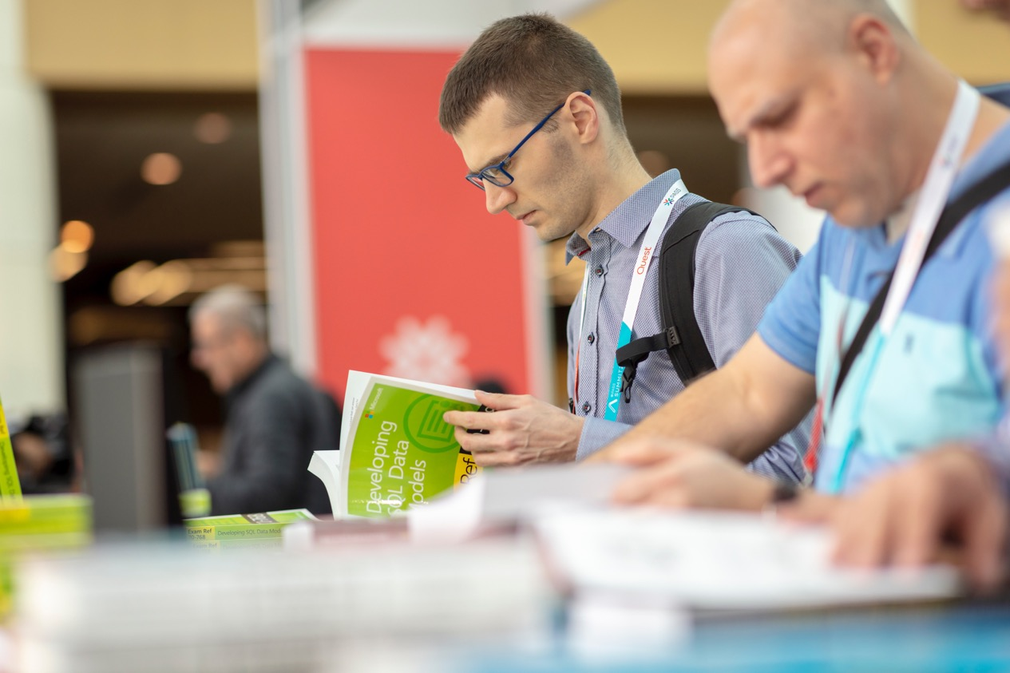
SQL Server makes implementing security easy. Correctly MANAGING security is hard.

Slide 23


Thank You to our Global SQLSaturday Sponsors

Slide 24
This event was sponsored by Microsoft Learn more about SQL Server 2019 today: -Get free training: aka.ms/sqlworkshops -Download the SQL19 eBook: aka.ms/sql19_ebook

Slide 25
Taking the First Steps Down the Road to Security
Rob.Douglas@datasentinel.co.nz,
Consultant, DataSentinel

